Slide 1
Enterprise System and Enterprise Architecture Considerations
Supply Chain Management (SCM)

Slide 2
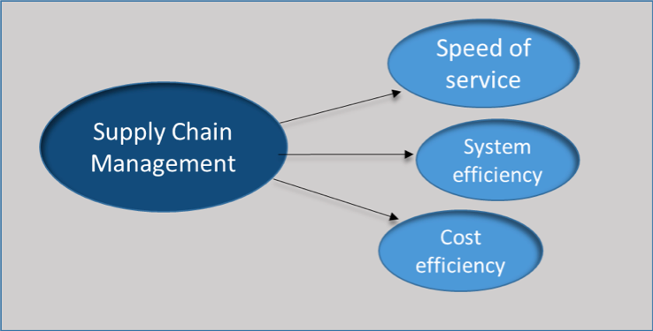
Benefits of Implementing SCM System
Novo Nordisk
Higher efficiency rate will allow maximization of revenue (Forni & Meulen, 2017).
Decrease cost effects will encourage more vendors.
Increased output covers a wider market area.
More production guarantees expansion of the company.
Notes:
SCM system will aid in adjusting the fluctuating economies. Emergency markets, and shorter product life-cycles will also be adjusted. Decrease cost effects improves the relationship for distributors and vendors. Increased output and production guarantee more production (Forni & Meulen, 2017).

Slide 3
Benefits of Implementing SCM System
Cisco
Increases the business profit level at all departments (Forni & Meulen, 2017).
SCM systems boost cooperation level for all employees.
Higher efficiency rate increases profits and revenue.
The company embraces flexibility, which increases production.
Notes:
Business profit level hence guaranteeing profits and revenue (Forni & Meulen, 2017). Cooperation is boosted since there is communication. Different businesses attempt to embrace the new technology. Flexibility and higher efficiency rate reduce stiff competition.

Slide 4

Limitations of Implementing SCM System
Novo Nordisk
Inadequate training since there is less timelines.
Mismanaged implementation since there is poor leadership (Namboodri, 2014).
The systems are complex since they are always technical.
SCM systems are costs and time consuming.
Notes:
Integrating new systems into the company is complex. It is vital to ensure team-member training. The training may be complex and involving (Namboodri, 2014). Changing a supply chain management system requires time. Financial investment and human resources are also needed. SCM systems require appropriately leadership patterns for unity.

Slide 5
Limitations of Implementing SCM System (Cont..)
Cisco
SCM demand very high costs upon implementation.
The systems demand a lot of time (Namboodri, 2014).
Poor strategic implementation affects vital operations.
SCM are involving and complex to apply.
Notes:
High costs solve complexity of technical systems (Namboodri, 2014). Systems demand a lot of time and resources. There is poor strategic implementation from poor management.

Slide 6
Considerations to the CIO
Novo Nordisk
Embracing an IT approach is fundamental (Namboodri, 2014).
Solving problems via identifying ways to prevent them.
Solving current issues to improve performance.
Cisco
Developing an IT approach is key to production (Namboodri, 2014).
Holding all members accountable for their actions.
Coming up with ways and to improve efficiency.
Notes:
For Novo Nordisk, CIO should embrace IT approach. This will maximization revenue and profits. He should concentrate to solve current issues. The CIO should identify the technical problems. Technical problems may improve efficiency and performance. For Cisco, IT ensures timely completion of activities. The CIO should be initiative and creative. This will allow more efficiency and dynamism (Namboodri, 2014).

Slide 7
Determining the best fit for the Organizations
Cisco
Standardized assessments are fundamental to companies.
Situational judgement tests should be embraced (CISCO Systems, 2012).
Involvement of everyone in the company is key.
Novo Nordisk
Studying the communication system is a key thing (Novo Nordisk Editors, 2019).
The application of standardized assessments in the company.
Arrangement of informal meet ups at any time .
Notes:
Standardized assessments aid understanding the company’s culture. Workers are able to respond to ‘real life’ job scenarios. Cooperation enables members to maximize production. Studying communication systems for Novo Nordisk is vital. It ensures important messages are passed quickly (Novo Nordisk Editors, 2019). Standardized assessments and the arrangement of informal meet ups. Meet-ups help members to align with the organizational culture.

Slide 8
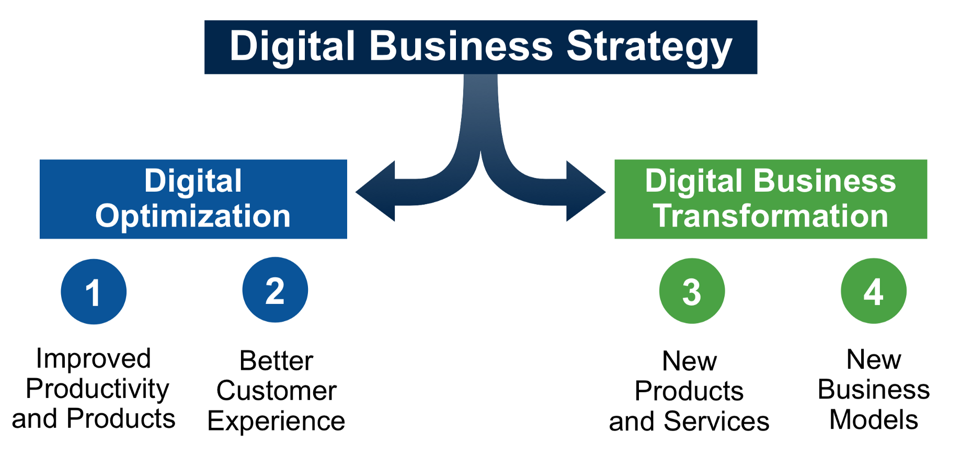
Implementation Planning and Success Criteria
Notes:
Novo Nordisk and Cisco improve services for their customers. Improving productivity of products is meant to attract more customers. Better customer experiences reduce stiff completion in the market. New business models and products improve performance.

Slide 9
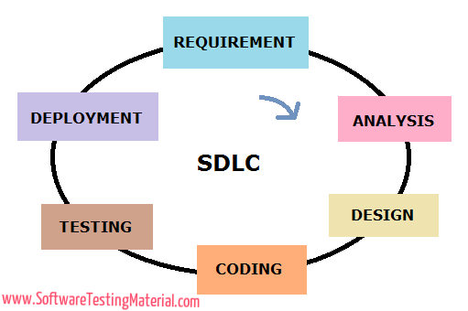
The Phases of the SDLC
Requirement gathering and analysis is the first stage (CISCO Systems, 2012).
Design removes possible flaws by setting standards.
Implementation or coding allows the pilot study.
Testing assesses the errors in the ground.
Deployment focuses on the tastes of the customers.
Maintenance allows up gradating of the products.
Notes:
The SDLC framework is vital as far development is concerned (CISCO Systems, 2012). In this case, Novo Nordisk and Cisco may apply the SDLC to be able to deliver a high-quality product which is as per the customer’s requirement. Requirement Gathering and Analysis helps to solve all ambiguities that may rise. In design, software architecture is applied to aid in the implementation of the system. Implementation allows the verification of components of the software. In addition, testing determines any defects and fixes them before they are serious. Deployment is conducted according to the expectations of the customer to cater for their preferences. Maintenance involves ensuring that the product has no defects and is ready to be consumed by the customer.

Slide 10
Conclusion
Companies must be flexible to make sure they change with the market.
Companies should prepare for the future.
Different models in businesses improve performance.
The focus of all companies is to ensure they improve production.
Notes:
All companies should embrace flexibility and more production. Different business models should be embraced. This varies with the nature of the company. Business models guarantee performance and productivity. Managers can implement strategies to increase productivity.

Slide 11
References
CISCO Systems. (2012). FORM 10-K Annual report pursuant to section 13 and 15(d), Part 1, Item 1. Washington, D.C.: SECURITIES AND EXCHANGE COMMISSION .http://pdf.secdatabase.com/419/0001193125-12-388590.pdf
Forni & Meulen. (2017, May 25). Gartner Announces Rankings of the 2017 Supply Chain Top 25. Retrieved from gartner.com: https://www.gartner.com/en/newsroom/press-releases/2017-05-25-gartner-announces-rankings-of-the-2017-supply-chain-top-25
Namboodri, C. (2014, June 06). Cisco Supply Chain Operations Places in Top 10 of Gartner Ranking. Retrieved from blogs.cisco.com: https://blogs.cisco.com/manufacturing/cisco-supply-chain-operations-top-10-gartner-ranking?dtid=osscdc000283
Novo Nordisk Editors. (2019). About Novo Nordisk. Retrieved from novonordisk-us.com: https://www.novonordisk-us.com/whoweare/about-novo-nordisk.html
Novo Nordisk Editors. (n.d.). Responsible Sourcing. Retrieved from novonordisk.com: https://www.novonordisk.com/sustainable-business/performance-on-tbl/responsible-business-practices/responsible-sourcing.html

